Slide 1
Barimbi : Jiringkijbi : Wandaraba
Waanyi – Fail : Learn (Discover) : Grow Up (Grow)

Slide 2
Wadda Mooli
Birri-gubba - greeting
This is our story

Slide 3
How it all began

Slide 4
Barimbi
Waanyi - Fail

Slide 5
An opportunity and a new direction – The timing was right

Slide 6
A tale of 2 friends

Slide 7
This story is about Country

Slide 8
Jiringkijbi
Waanyi – Learn (Discover)

Slide 9
3 principles:
Nation, country and/or language, place of country
‘Unrecorded’ to describe missing information (replacing ‘unknown’)
‘Untitled’ to describe works where title is not known or does not exist
Napangati, Y 2018, Untitled, painting, Papunya Tula, Northern Territory, Art Gallery of NSW, viewed 20 March 2019, https://www.artgallery.nsw.gov.au/prizes/wynne/2018/30021/

Slide 10
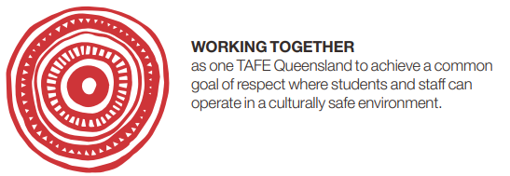
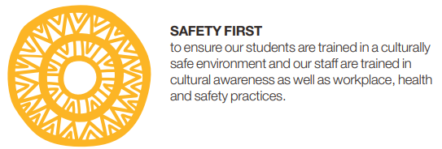
TAFE Queensland Reconciliation Action Plan

Slide 12
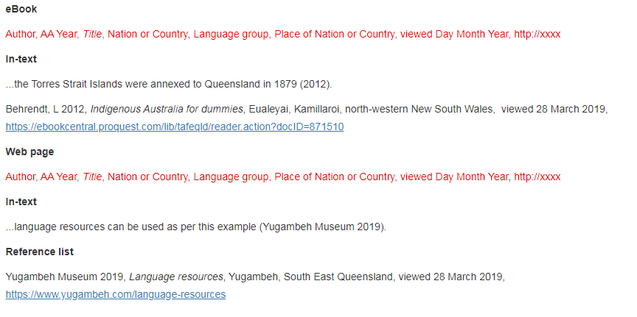

Slide 13
Manku
Waanyi - Listen

Slide 14
Wandaraba
Waanyi – Grow up (Grow)

Slide 15
Wadda Mooli
Birri-gubba – farewell
This is our journey

Slide 16
References
Creative Spirits. (2019). Meaning of land to Aboriginal people. Retrieved from https://www.creativespirits.info/aboriginalculture/land/meaning-of-land-to-aboriginal-people
Janke, T. (2018). Retrieved from https://www.amaga-indigenous.org.au/
Mungo National Park. (2019). Aboriginal country. Retrieved from http://www.visitmungo.com.au/aboriginal-country
Salam, R. (2019). knowledge-connecting [Graphic art]. Kala Lagaw Ya, Western Islands Group, Kuku Yalanji. Cairns QLD: TAFE Queensland.
TAFE Queensland. (2019). Reconciliation action plan. Retrieved from https://tafeqld.edu.au/assets/oneweb/PDF/about-us/TAFE-Queensland-RAP-2018-2020-endorsed.pdf
University of Technology Sydney. (2019). Indigenous materials. Retrieved from https://www.lib.uts.edu.au/help/referencing/harvard-uts-referencing-guide/indigenous-material
Watson, J. (2018) oodjamulla[Private video]. Waanyi, North West QLD. Retrieved from https://vimeo.com/339267830

